Slide 1
INDIAN BULLS
GANESH KUMAR.K
AJAY SOBI.S
MADHAN KUMAR.S
KARTHIKEYAN.R
VIGNESH.N

Slide 2
SYNOPSIS
INTRODUCTION
GIS based security interface
GSM SIM900A MODEM
BLOCK DIAGRAM
CONNECTIONS
CONCUSION

Slide 3
Introduction
The issue of security for women and children can be dealt by providing a safety process. Adding GPGS to find the location of the threatened person. It provides self confident for the women who travels a lot .The GIS based security interface can be used for these purposes . Using the main concept of tracking, the exact location of the threatened person can be found and also used to make a call and send text messages to the police and also to the persons who are close to them.

Slide 4
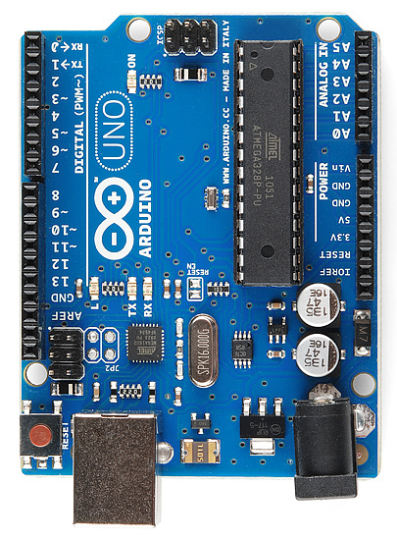
GIS BASED SECURITY INTERFACE
Arduino is an open-source platform used for building electronics projects. ... Unlike most previous programmable circuit boards, the Arduino does not need a separate piece of hardware (called a programmer) in order to load new code onto the board – you can simply use a USB cable.
Aruino is an open source computer hardware and software company, project, and user community that designs and manufactures single-board microcontrollers and microcontroller kits for building digital devices and interactive objects that can sense and control objects in the physical and digital world

Slide 5
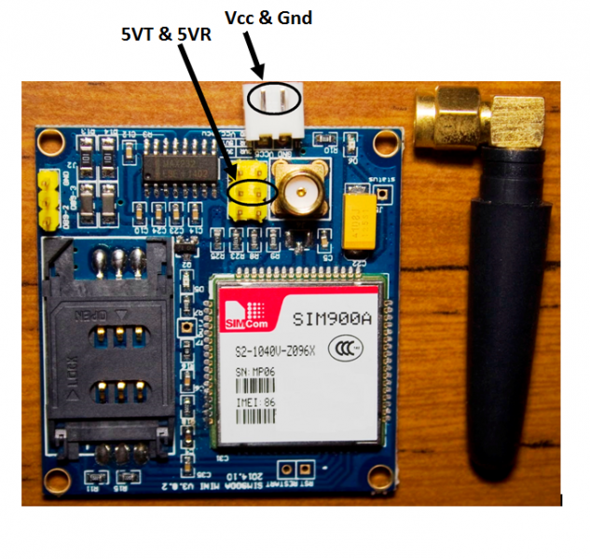
GSM SIM900A MODEM
This is an ultra compact and reliable wireless module. The SIM900A is a complete Dual-band GSM/GPRS solution in a SMT module which can be embedded in the customer applications.
Featuring an industry-standard interface, the SIM900A delivers GSM/GPRS 900/1800MHz performance for voice, SMS, Data, and Fax in a small form factor and with low power consumption. With a tiny configuration of 24mmx24mmx3mm, SIM900A can fit in almost all the space requirements in user applications, especially for slim and compact demand of design.

Slide 6
BLOCK DIAGRAM
LOCATION TRACK
MESSAGE
A
R
D
U
I
N
0
U
N
O
VOICE CALL
G
S
M
M
O
D
U
L
E
KEY
POWER SUPPLY(12V)

Slide 7
CONNECTION
A
R
D
U
I
N
O
U
N
O
G
S
B
M
O
D
U
L
E
900A
D0
TX
D1
RX
TX
RX
GND
GND

Slide 8
A
R
D
U
I
N
O
U
N
O
G
S
B
M
O
D
U
L
E
900A
D0
TX
D1
RX
GND
GND

Slide 9
CONCUSIONS
Thus the GIS based security interface has been constructed and tested and can be further developed to advanced technology to bring it into our day to day life

